Slide 1
Purpose Focused Stewardship:
Ten Ways to Increase Giving to Your Church
Transforming Church Finances
Alan L. Griffin (agriffin46526@comcast.net)

Slide 2
Typical Stewardship Programs:
Done Faithfully but Done Wrong!
Session projects coming year’s budget (may be rough draft)
Interprets budget to congregation
  Newsletter articles, Minutes for Mission, letters, brochures
  Pastor preaches motivational stewardship sermon on single stewardship Sunday
  Pledge Cards toward coming year’s budget circulated by
    US mail
    Handed out in church
    Pony Express or other house to house system
Pledge Cards returned by due date
Session totals pledge cards totaled, adjusts budgets, dedicates pledges in worship
Following year, process repeated

Slide 3

1. Start with Why

Slide 4

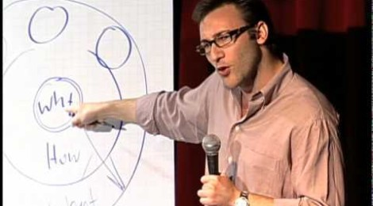
Start With Why

Slide 5
Mission Interpretation—we have to have something to support!
Members give to a variety of charities—why should they give to the church?
Interpretation helps us understand how God’s assets are being used in our midst.
  Mission—what we’re here to do
  Values—why it’s important
  Stories—people’s lives are being changed
3. People do not give to the church because it has needs…
  People give to the church because it meets needs!

Slide 6
Talk about the Mission of the Church
Help members understand importance of giving beyond self
Session models for members—personal giving (all pledge/give) and budget gifts to mission
Pictures of what mission it does as well as ministry
Be proud to be a Presbyterian—we often take for granted the special attributes of our church
Contact Presbytery/Synod/General Assembly for materials on “mission beyond our doors”

Slide 7
2. Eliminate Secrecy Surrounding Money
  The financial life of the church should be fully transparent.
  The congregation should receive:
  Regular statements of their giving,
  Regular reports on the spending of the church,
  Prompt, truthful, and forthright answers to all questions about spending.
  It should be clear that
  the Session exercises prudent judgment in its stewardship responsibilities;
  that gifts will be used for the purposes for which they were given.

Slide 8
2. Eliminate Secrecy Surrounding Money
Pastors should know what people give. Pastors should respond whenever:
    Someone new starts giving regularly.
    Someone stops giving or significantly decrease their giving.
    Someone gives a gift for a special purpose.
    Someone is being considered for a top leadership position.
    Someone has shown the capacity to give generously.
  Additionally it is helpful for a pastor to know giving patterns and levels .
  Saves a pastor from judging a person by secular values of prominence, community status, of flashy signs of wealth
  Prevents the spiritually immature from attempting to bully the leadership into letting them control the church.

Slide 9
Eliminate Secrecy Surrounding Money
Many clergy and laity see money-talk as Taboo
The problem is language: how do we talk about faith and giving.
Pastor must model their role as Chief Steward
Don’t dodge the Biblical texts dealing w. money
Preach about money and the wise use of possession, but not during the campaign. Separate your teaching about money from your asking for money.

Slide 10
3. Pastor and Session Must Lead
Pastors must overcome difficulty in talking about money. After all, much of Jesus’ teaching was related to our relationship with money and the call to generosity.
We must pray study and get our act together.
Elders should practice “money-talk” as redemptive conversation.
Sessions should consider creating their own theological statement on Christian financial stewardship.

Slide 11
3. Pastor and Session Lead
Know our theological tradition when it comes to money talk.
Invite people to ponder moral questions. Open-ended moral inquiry awakens the capacity for self-insight and self-criticism
Tell stories that illustrate faithfulness and the creative use of possessions. We want to create some “aha” moments as the say to themselves: “Wow, that is something that I could do.”

Slide 12
3. Pastor and Session Must Lead
Pastors must claim their role as the chief stewardship leader in the congregation
Pastors should preach and teach regularly on stewardship and the role of money in our lives.

Slide 13
4. Use a Narrative Budget
It is the sacred story of the ministry of the congregation
One of the most important ways we can effect on-going stewardship education
Narrative Budgeting is an essential element in educating your congregation about how their money is being utilized to support the ministry of the congregation

Slide 14
An important insight is the backbone of Narrative Budgeting…
Donors don’t give their money TO the church…
…they give THROUGH the church to touch the lives of other people
People will give generously when they feel their money is having an impact

Slide 15
Sacred story…
Much of Scripture is the sacred story of God’s care for the people of God. ie. Exodus 16 and Manna from heaven.
Just as individuals have sacred stories of God’s providential care for them…
…a narrative budget is the sacred story of your congregation’s ministry and how your members are giving through their congregation to touch the lives of other people

Slide 16
A new way of thinking
Line item budgets are an accounting tool
Narrative budgets are an educational and visioning tool
We need both but we must be more intentional in how we use both

Slide 17
Line item budgets have serious limitations
They do not show how money is being invested in ministry
They do not show how volunteer time and talent are impacting congregation life
Worst of all – they do not inspire!

Slide 18
The Narrative Budget
Clearly shows how money is being invested in the various components of congregation life
Helps donors to re-frame what the congregation is all about
Inspires donors and helps them see their donations are really making a difference
Is a proven tool for increasing financial commitment to the ministry of the congregation

Slide 19
The Narrative Budget
  Put “faces” on the budget numbers
  Use the current budget to thank members for their support
  Focus on ministry areas (worship, education, outreach, etc.) rather than on budget categories (personnel, facilities)
  Prioritize ministry areas from congregation’s perspective (e.g., worship is where most members make contact with the church and thus priority #1)

Slide 20
4. Use a Narrative Budget
Step One:
Identify your congregation’s
areas of ministry

Slide 21
Each congregation has several key components to their ministry…
Your congregation’s ministry might easily be segmented into these six components:
Pastoral Care Education
Worship Evangelism and Hospitality
Outreach Congregational Life

Slide 22
Experience shows Six Categories seems to be 0ptimum
This means you will have to make some decisions about what categories are right for your congregation.
Some congregations like a youth ministry category. I have found it easiest to fit both Youth Ministry and Stewardship Education into the ‘Education’ segment
However, you could put Youth Ministry in the ‘Outreach’ or ‘Evangelism’ categories if that makes more sense for your congregation.

Slide 23
Notice what category is NOT included in a Narrative Budget
Pastoral Care
Christian Education
Worship
Evangelism and Hospitality
Outreach
Congregational Life
Do you see the ADMINISTRATION or PERSONNEL category on this list??

Slide 24
If you use ADMINISTRATION as a category in your Narrative Budget
You will be defeating the entire purpose of Narrative Budgeting!!!
Please . Don’t go there!
Assign Personnel and Building Costs to Ministry areas

Slide 25
4. Use a Narrative Budget
Step Two:
Apply each budget line item to one or more area of ministry.
Assign staff time to the various ministry areas.
Assign building costs to the ministry areas.

Slide 26
So after a month of keeping time diaries by your staff you will have an allocation formula
For example, the pastor might spend 15% of his/her time on Christian Education; 10% on Outreach; 30% on Worship and Worship preparation; 10% on In-reach and Fellowship; and 15% on Evangelism and Hospitality and the remaining 20% on Pastoral Care
We then take this formula and use it as a blueprint for line items that are difficult to allocate

Slide 27
Don’t get caught in a trap
Many congregations implementing Narrative Budgeting for the first time miss a big point – they get too caught up on delivering accuracy and don’t give themselves permission to treat the Narrative Budget as directional.
Its not that we deliberately try to be inaccurate. We try to be as accurate as possible but we also recognize that, as an educational tool, helping reframe minds and getting donors to think about how their donation is used is more important than accuracy

Slide 28
4. Use a Narrative Budget
Step Three:
List examples of mission in each area of ministry.

Slide 29
4. Use a Narrative Budget
Step Four:
Write a descriptive paragraph
for each area.

Slide 30
4. Use a Narrative Budget
Step Five:
Prepare a narrative budget
brochure.

Slide 31
4. Use a Narrative Budget
Step Six:
Use the narrative budget to make decisions and to tell your congregation’s story.

Slide 32
Here’s what you will have when you are done your first Narrative Budget…

Slide 33
These calculations are fed into a software spreadsheet to produce the following pie chart:

Slide 34
The software also permits the budget to be expressed in percentages:

Slide 35
Or the software lets you look at individual slices of the pie…

Slide 36
The net takeaway we want donors to have is this:
14 cents of every dollar I give goes to Pastoral Care
34 cents of every dollar I give goes to Outreach
etc.

Slide 37
I strongly recommend…
…that you leave the line item budget in the office at your annual meeting.
Take only the Narrative Budget to your annual meeting

Slide 38
You can still make the line item budget available
…tell the left brain accountant types in the congregation that there are copies of the completed line item budget available in the office for anyone interested. You are not compromising transparency.
As a faith-based organization be determined in your desire to talk about money and ministry in a new way. Don’t vacillate and fall back on the line item budget for decision-making.

Slide 39
5. Create a High Expectation
Congregation
DNA
    Mission Statement
    Congregational Covenant
    Leadership Covenant
    Changes in Bylaws
    New Members Classes

Slide 40
6. Don’t Treat
Everyone
the Same

Slide 41
Most Money is Given By a few
10% of members give 50% of support
10% give 30% (20% give 80%)
30% give 10%
50% give 10% (33% give nothing at all)
Different situations, resources and interests: Does it make sense to treat all people the same?

Slide 42
Don’t Treat Everyone the Same
Send different letters to different levels of givers.
Visit the top 10 % of givers before your annual campaign begins and get their input.
Don’t publish weekly giving amounts in bulletins, and NEVER talk about fair share giving amounts.

Slide 43
7. Recognize
Generational Differences

Slide 44

The Next Generation of American Giving
A study on the multichannel preferences and charitable habits of Generation Y, Generation X, Baby Boomers and Matures
March 2010

Slide 45
7. Recognize Generational Differences
In the annual stewardship effort,
target the message, design the experience
    Multiple mailings, generationally specific
    Generationally sensitive brochures, letters, and appeals
    Include younger members in planning and executing the stewardship effort; many times, younger members have little idea of how much money it takes to run a church!

Slide 46
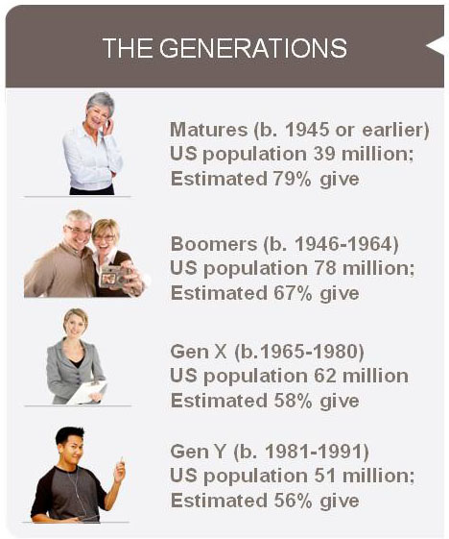

Slide 47
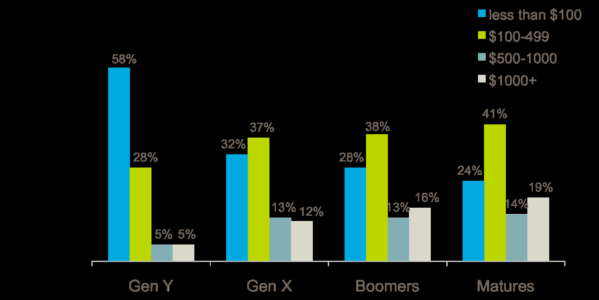

Generational Groups and Average Contributions per Year

Slide 48
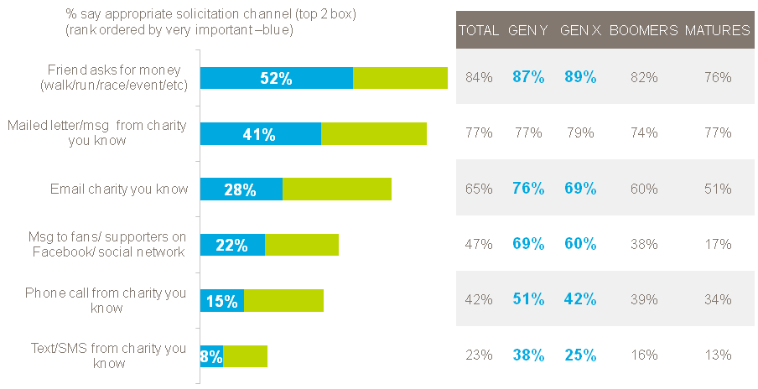
Recognize Generational Differences
Solicitation Channel Appropriateness Overall

Slide 49
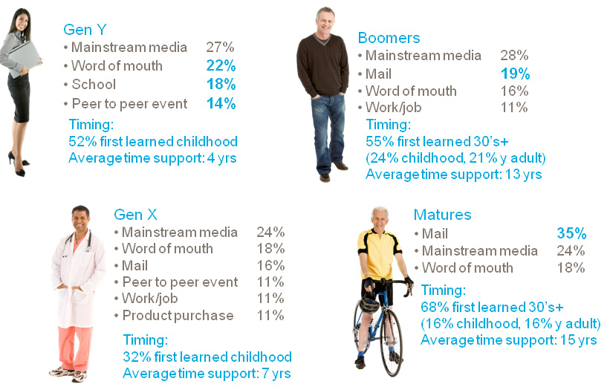
Recognize Generational Differences
How Donors Learned About Their Top Charity

Slide 50
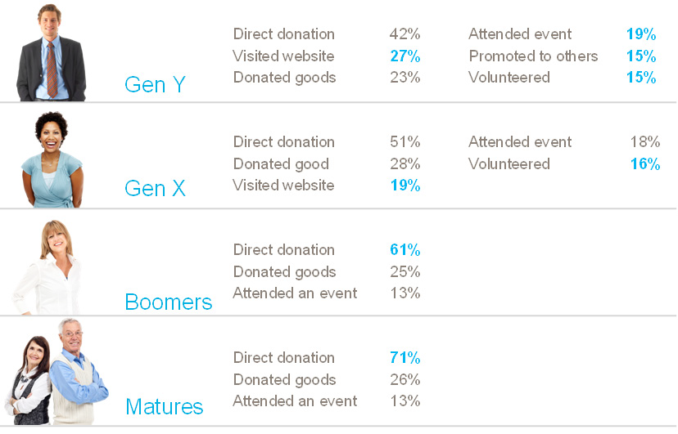
Recognize Generational Differences
First Form of Engagement with Top Charity

Slide 51
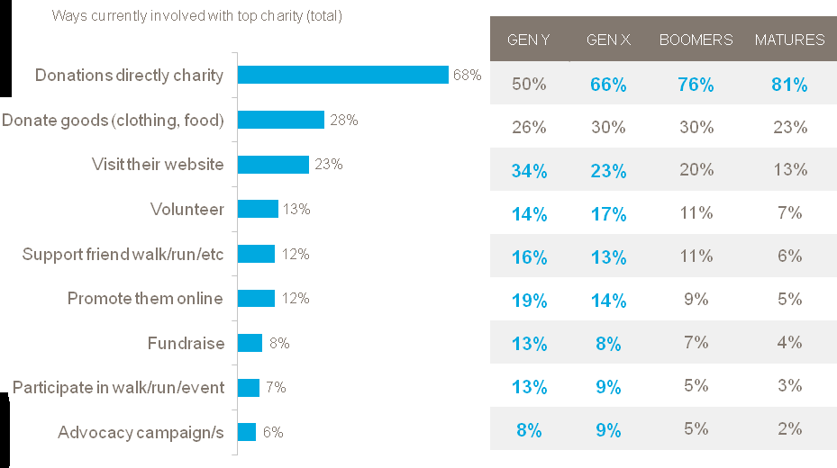
How Donors want to Engage

Slide 52
Generational Giving Preferences
Each generation likes to make donations to churches in different ways. Smart congregations provide a variety of giving options.
Matures like to use offering envelopes
Boomers like to write checks
Gen X prefer electronic giving (credit, debit, e-checking)
Gen Y like to use their smart phones
Gen Z gives cash, usually provided by parents

Slide 53


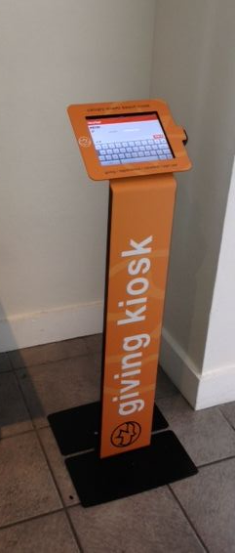

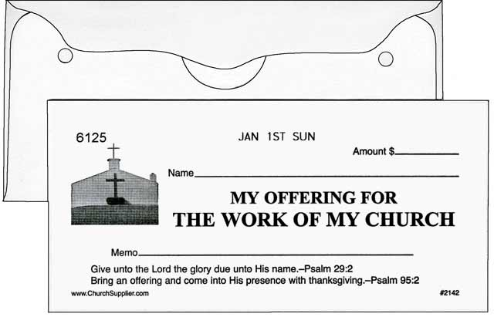
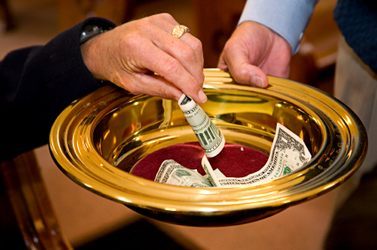

Slide 54
8. Get Your Story Out
>

Slide 55
Tell your Story
  Remember people give to mission …..
  not budgets.

Slide 56
Use Sunday worship to tell the sacred stories
  Have Weekly Mission and Ministry Stories as part of the Offering. Tell a specific story of a person being touched by that ministry
  Pray for that ministry during the prayers of the people
  Put a bulletin insert out each week for six weeks highlighting a different category of ministry in Nar. Budget
  Have monthly witness of transformed lives , drop the Offertory special music if you need the time.

Slide 57
There are many ways we can use to get the story out
Blogs
Session reports
congregation newsletter
Bulletin inserts
Projected slides
congregation website, Facebook
Fall Stewardship mailings
Narrative Budgeting booklets
Personal contact
Include in intercessory prayers

Slide 58
9. Treat Your annual financial campaign as a “Campaign”
8 Types of Campaigns :
Every member Visitation
Small Group Meetings
Sunday Worship
Direct Mail
Congregational Dinner
Telephone Approach
Consecration Day
Personal Delivery

Slide 59
Treat Your Annual Financial Campaign as a “Campaign”
Some Don’ts
Don’t try to do it all by yourself – create a Team or Task Force. The more people involved in a Stewardship Commitment Program, the more successful you will be.
Don’t cut corners – do it First Class or don’t do it at all.
Don’t be afraid to spend money on the campaign, you have to spend money to make money.
Don’t be afraid to ask the congregation to increase their level of giving—if you don’t ask, the congregation seldom responds.
Don’t use a Line item budget or a “Dream Budget” in attempting to tell the church’s mission story.
One stewardship letter will not fit the entire congregation. Send different letters to different people—make specific requests.

Slide 60
Treat Your Annual Financial Campaign as a “Campaign”
Some Do’s
Recruit a Stewardship Team
Develop a narrative budget
Include the children
Show levels of giving in congregation
Use an outside preacher
Inform the congregation on progress
Thank the pledgers
Give it your absolute best!

Slide 61
Treat Your Annual Financial Campaign as a “Campaign”
Some Do’s
Do it yourself
Cut corners
Do it First Class… or don’t do it at all.
Be afraid to spend some money
Neglect to ask the congregation to increase their pledges
Use a “line item” budget
Use a “One Letter Fits All” mailing

Slide 62
Treat Your Annual Financial Campaign as a “Campaign”
Same process for a capital campaign can be put into the annual campaign
Confidential—not secret—information (only those who need to know will know information)
Carefully selected committee—connection, concern and capacity—keep small (2-4 people)
Farm out parts of campaign—mailings, dinners, gatherings, etc.—to include more people
Clearly articulate purpose—why support the church’s ministry—don’t assume people know!
Contact church leaders and key members for leadership gifts—called the “silent phase”
Help everyone be a part—called the “public phase”
Make a plan

Slide 63
Treat Your Annual Financial Campaign as a “Campaign”
It rarely matters what we do—as long as we do it well!
Personality of the campaign should be similar to personality of pastor and congregation
“Stretch a little” by making a little more crazy or a little more refined—shows importance
Be honest about money and what it will do—“This is what we are doing…and this is what we would like to do…these are not my/our priorities…these are the values this congregation has identified …these are our values…these are our ministries....”

Slide 64
Treat Your Annual Financial Campaign as a “Campaign”
This is important—demands time, attention and resources
Begin as early as possible
Set deadlines—meet regularly and hold people to them—shows value and importance
Presentation is vital—use your best people in public

Slide 65
Treat Your Annual Financial Campaign as a “Campaign”
Make it personal
Average letter is held less than four seconds—including the ones they read!
Personal contact is most effective way to share information—shows respect for person and importance of mission
Share with members who can make the biggest difference—who has most potential?
Don’t coerce or pressure—thank them for past support and share future ministry
Let your personality, their personality and your relationship determine your conversation

Slide 66
Create a Year Round Stewardship Education Program
We, the church, need to make our case /tell our story of vision and impact
We, the church, must change our dialogue on money.
Relationships make a difference.
Individuals are looking for ways to make an impact. They want to transform the world and their church is one of the ways this can happen.

Slide 67
Create a Year Round Stewardship Education Program
We are all on a financial discipleship journey.
Stewardship education includes newsletter articles, bulletin blurbs, small group materials, Sunday School curriculum, etc.

Slide 68
Create a Year Round Stewardship Education Program
  Have Mission and Ministry Stories as part of the Offering every Sunday morning.
  Remember People give to mission not budgets.
  Have monthly witness of transformed lives

